Slide 1
The Value of Independent Research
or How tu be teh Uber l33t Nolage Mastre lyk Yoda

Slide 2
What IS independent research?

Slide 3


Slide 4
What IS independent research?
Something you do by yourself, alone in your room, probably at night in the dark, usually in front of a computer...
Active, self driven research which can involve:
reading technical reports
watching presentations
testing and trialling theories
summarising your findings
Definitely not the passive “listen and learn approach”:
Answers will NOT be found from just one source
Hunt through a variety of sources to “piece together” information

Slide 5
Why do people do it?

Slide 6


You could be this man

Slide 7
...or professor sharkman

Slide 8


...or these smart Guys

Slide 9

...or these smart Chicks

Slide 10
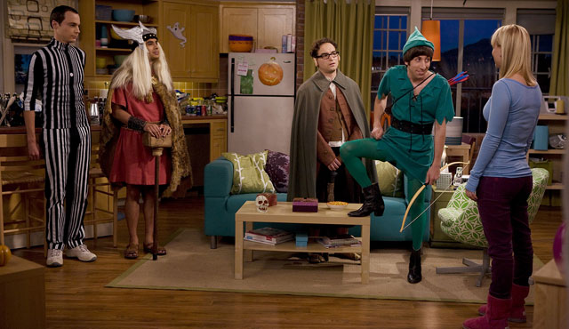
...or these Totally hawt Dudes

Slide 11
Why do people do it?
It’s extremely satisfying
Get the feeling that there HAS to be a better way to do a thing...
Just because no one has done it before doesn’t mean that it can’t be done...
Increases skills and knowledge that can be contributed to a company or an indie team
Sets you apart from the cookie-cutter junior graduates
Significantly increases your value to a team
You’re better equipped to compete as an indie game designer
More likely to be in a Senior or Lead position
You’ll often be the one setting the production standards for the team
It’ll be your responsibility to find solutions to the WEIRDEST problems

Slide 12
What’s in it for YOU?
That research satisfaction can lead to increased intellectual stamina and greater appeal amongst the academic honeys
Bring us your brains – your research contributes to the growth and innovation in the games industry in Australia
Know your shit - Increased self-confidence in your own skills and ability
Demonstrable evidence of your ability to learn quickly and contribute to the knowledge capital of a company – extremely employable skill
White Paper material that can be used in networking, building a personal brand, speaking at conferences etc
Increased skillz:
Expert Communication (writing, presentation, and argument)
Advanced Leadership (pwn teh bosses, run teh guilds)

Slide 13
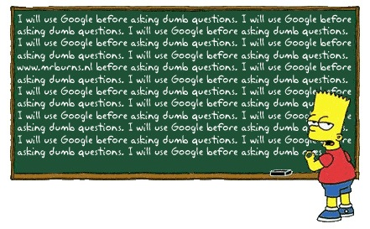

Slide 14
Final note...
10,000 Hour Rule

